Slide 1

Housing Project
Submitted by:-
AKSHAY DINESH SHAH

Slide 2
Problem Statement
A US-based housing company named Surprise Housing has decided to enter the Australian market.
The company uses data analytics to purchase houses at a price below their actual values and flip them at a higher price.
The company has collected a data set from the sale of houses in Australia in order to analyze and predict the sale prices.
The company is looking at prospective properties to buy houses to enter the market.

Slide 3
Exploratory Data Analysis
This is a regression problem. The target variable contains numeric integers in a large scale.
Variable Data-types:
There are integer, float and objects types.
Null Values: There are Null values in the dataset.
Shape: There are 1460 records and 80 features + 1 target variable in the train data. There are 202 records and 80 features in the test data.
The dataset has both numerical and categorical features.

Slide 4
Exploratory Data Analysis .
Descriptive Statistics:
There are some outliers in the dataset.
All the numerical variables are moderately skewed. The means of the variables are larger than their medians.
The numerical variables are in different scales.
Some of the variables have high standard deviation.
There are some extreme outliers in the data based on the max values and the values in the 1st, 2nd and 3rd Quartiles.
Extensive Data cleaning was performed on majority of the variables.

Slide 5
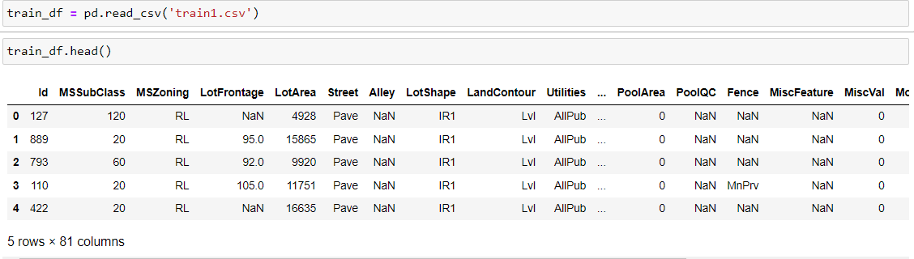
We First Loaded Training dataset

Slide 6

Data Visualizations

Slide 7
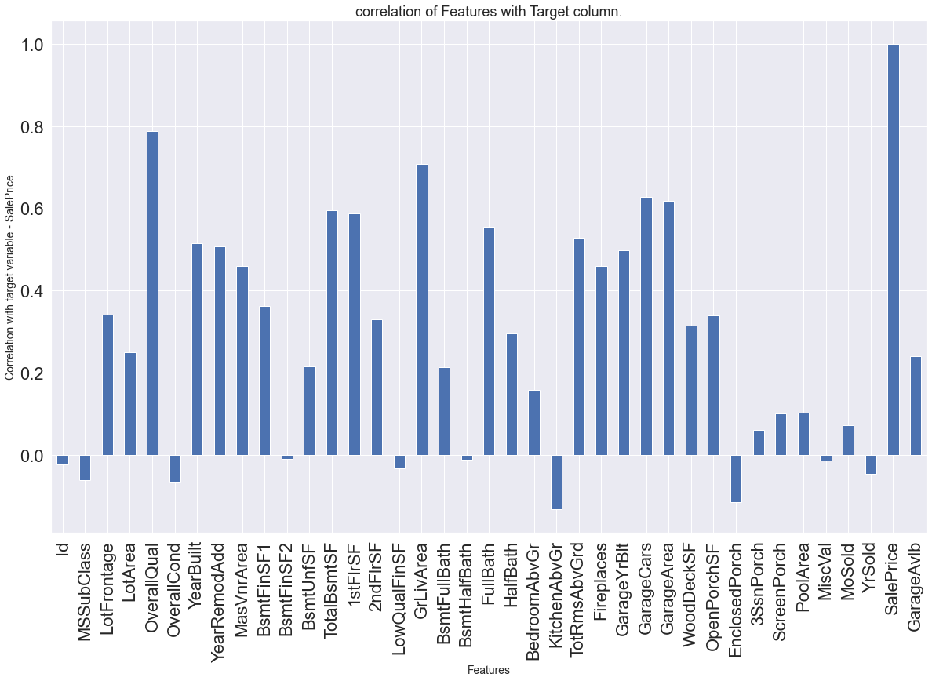
Correlation with target variable – ‘Sale Price’

Slide 8
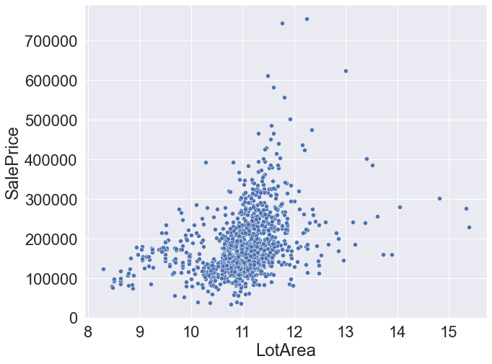
LotArea vs SalePrice

Slide 9
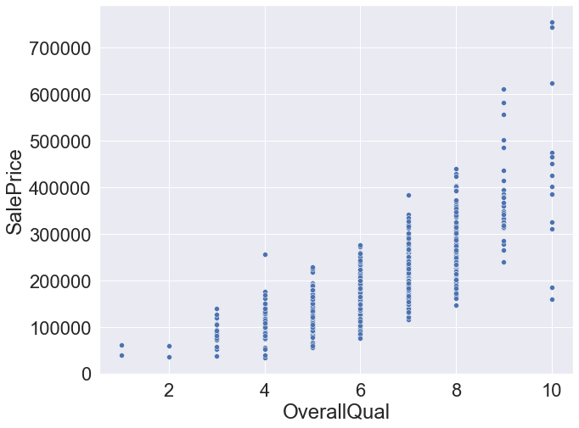
It is observed that 'Overall Qual' is positively correlated with 'Sale Price'

Slide 10
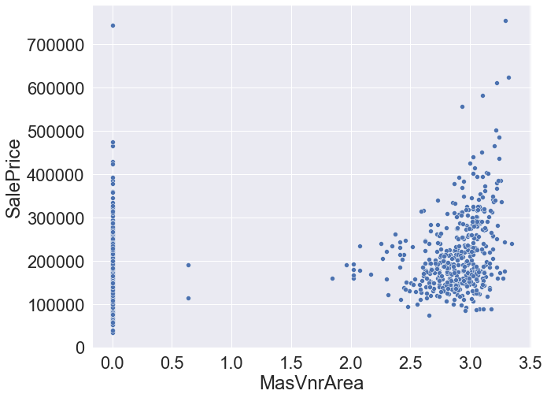
It is observed that ‘MasVnr’ Area' is NOT positively correlated with 'Sale Price'

Slide 11
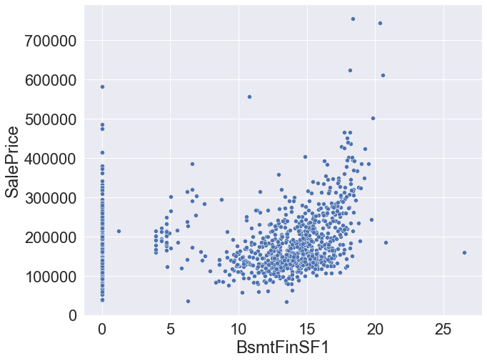
It is observed that 'BsmtFinSF1' is positively correlated with 'Sale Price'

Slide 12
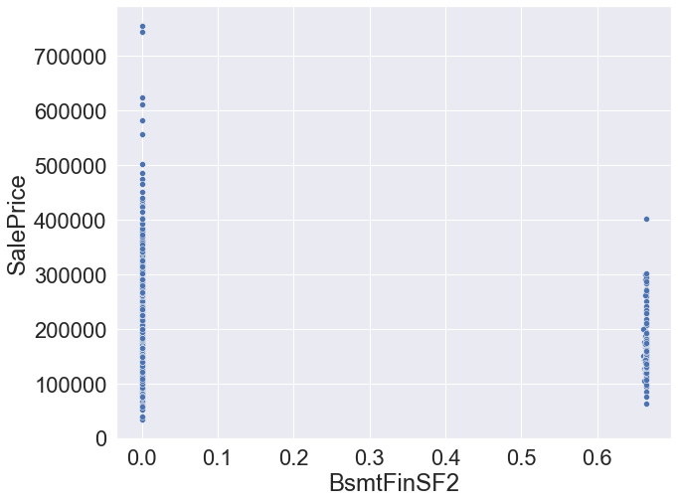
It is observed that 'BsmtFinSF1' is positively correlated with 'Sale Price'

Slide 13
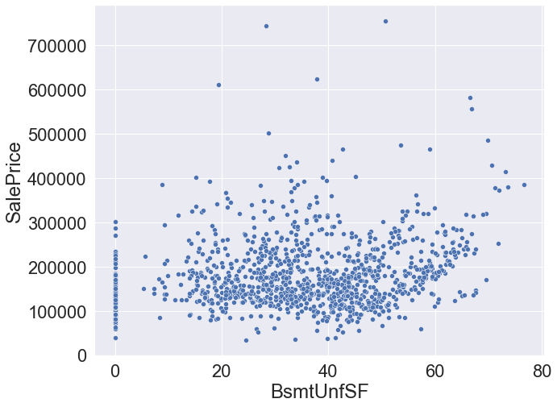
It is observed that 'BsmtUnfSF' is Slightly positively correlated with 'Sale Price'

Slide 14
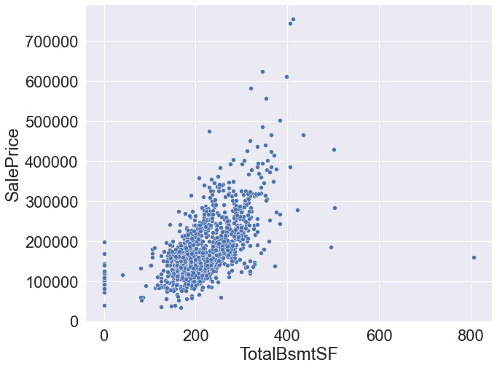
‘TotalBsmtSF’ and ‘SalePrice’ have a positive correlation and relationship shows linearity.

Slide 15
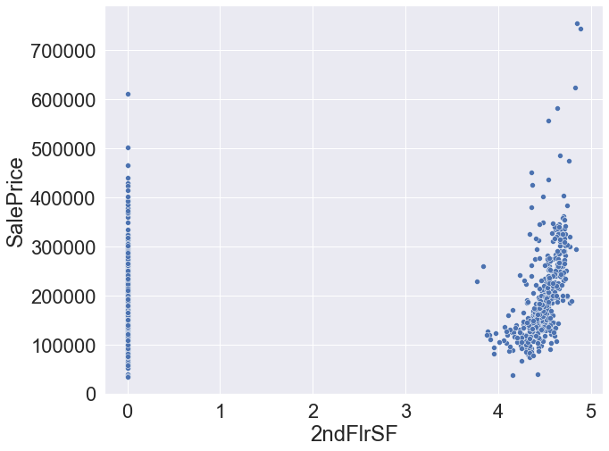
It is observed that '2ndFlrSF' is positively correlated with 'Sale Price'

Slide 16
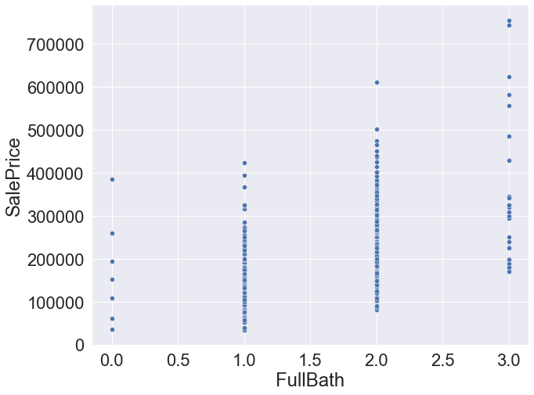
There is positive correlation between ‘FullBath’ and ‘SalePrice’.

Slide 17
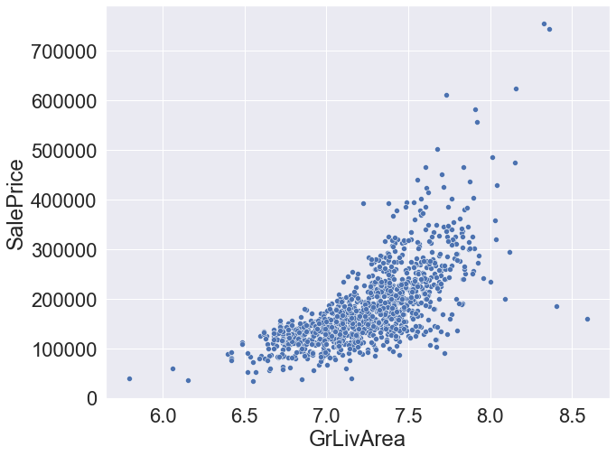
It is observed that 'GrLiv Area' is GOOD positively correlated with 'Sale Price'

Slide 18
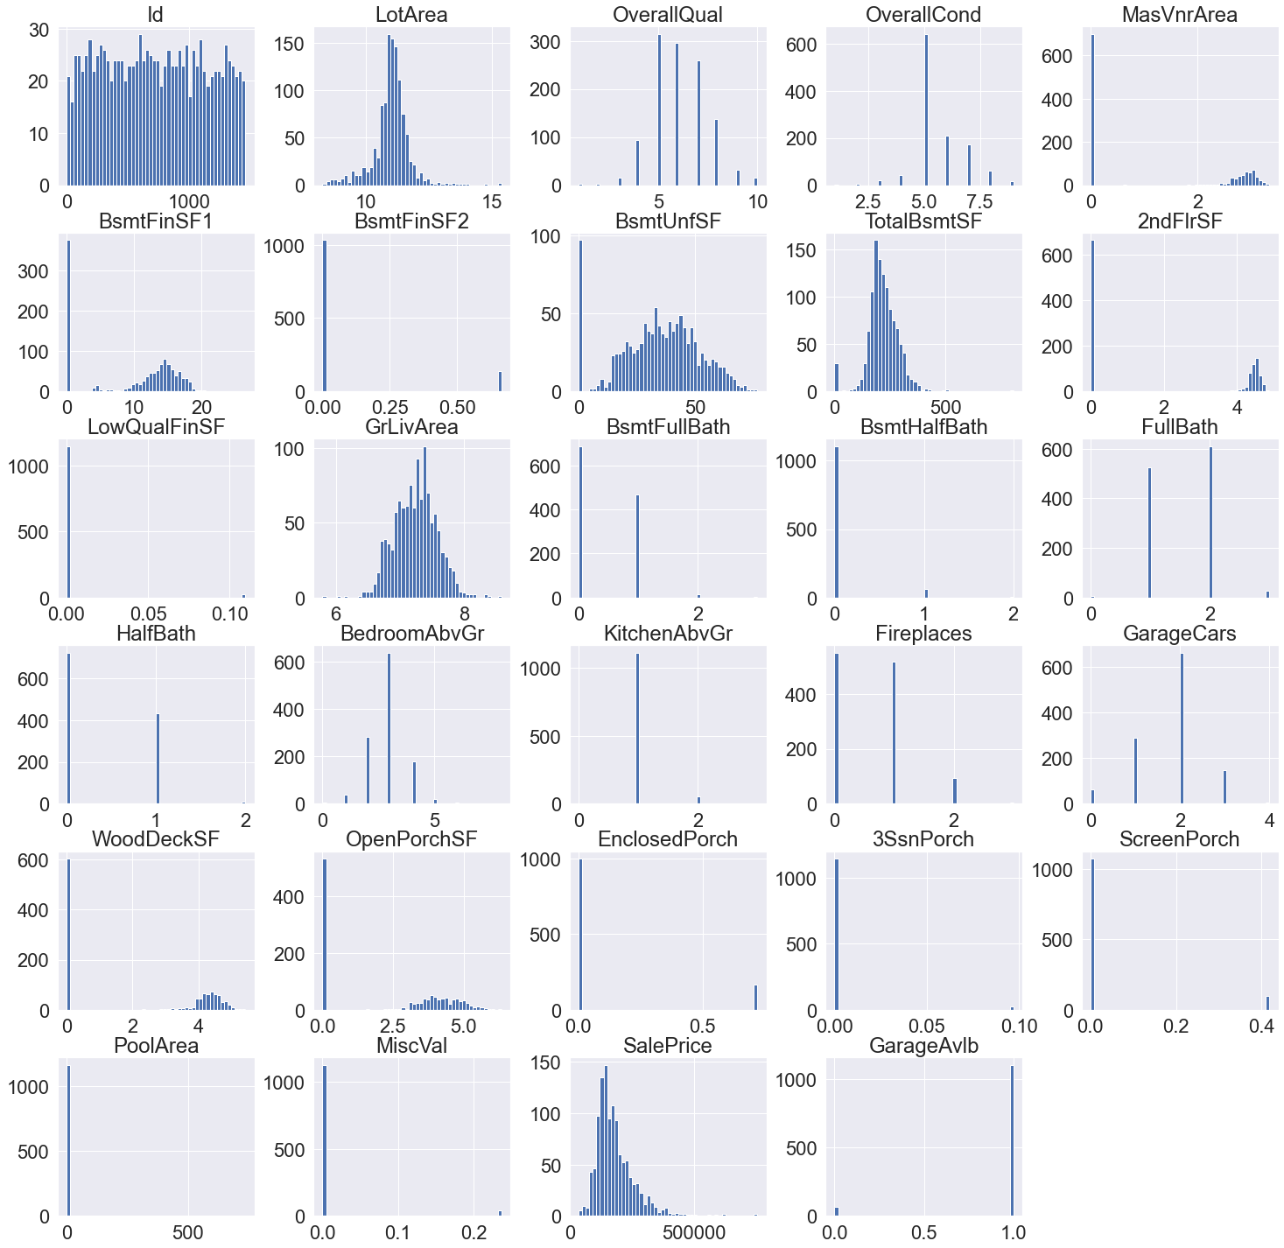
Skewness:

Slide 19
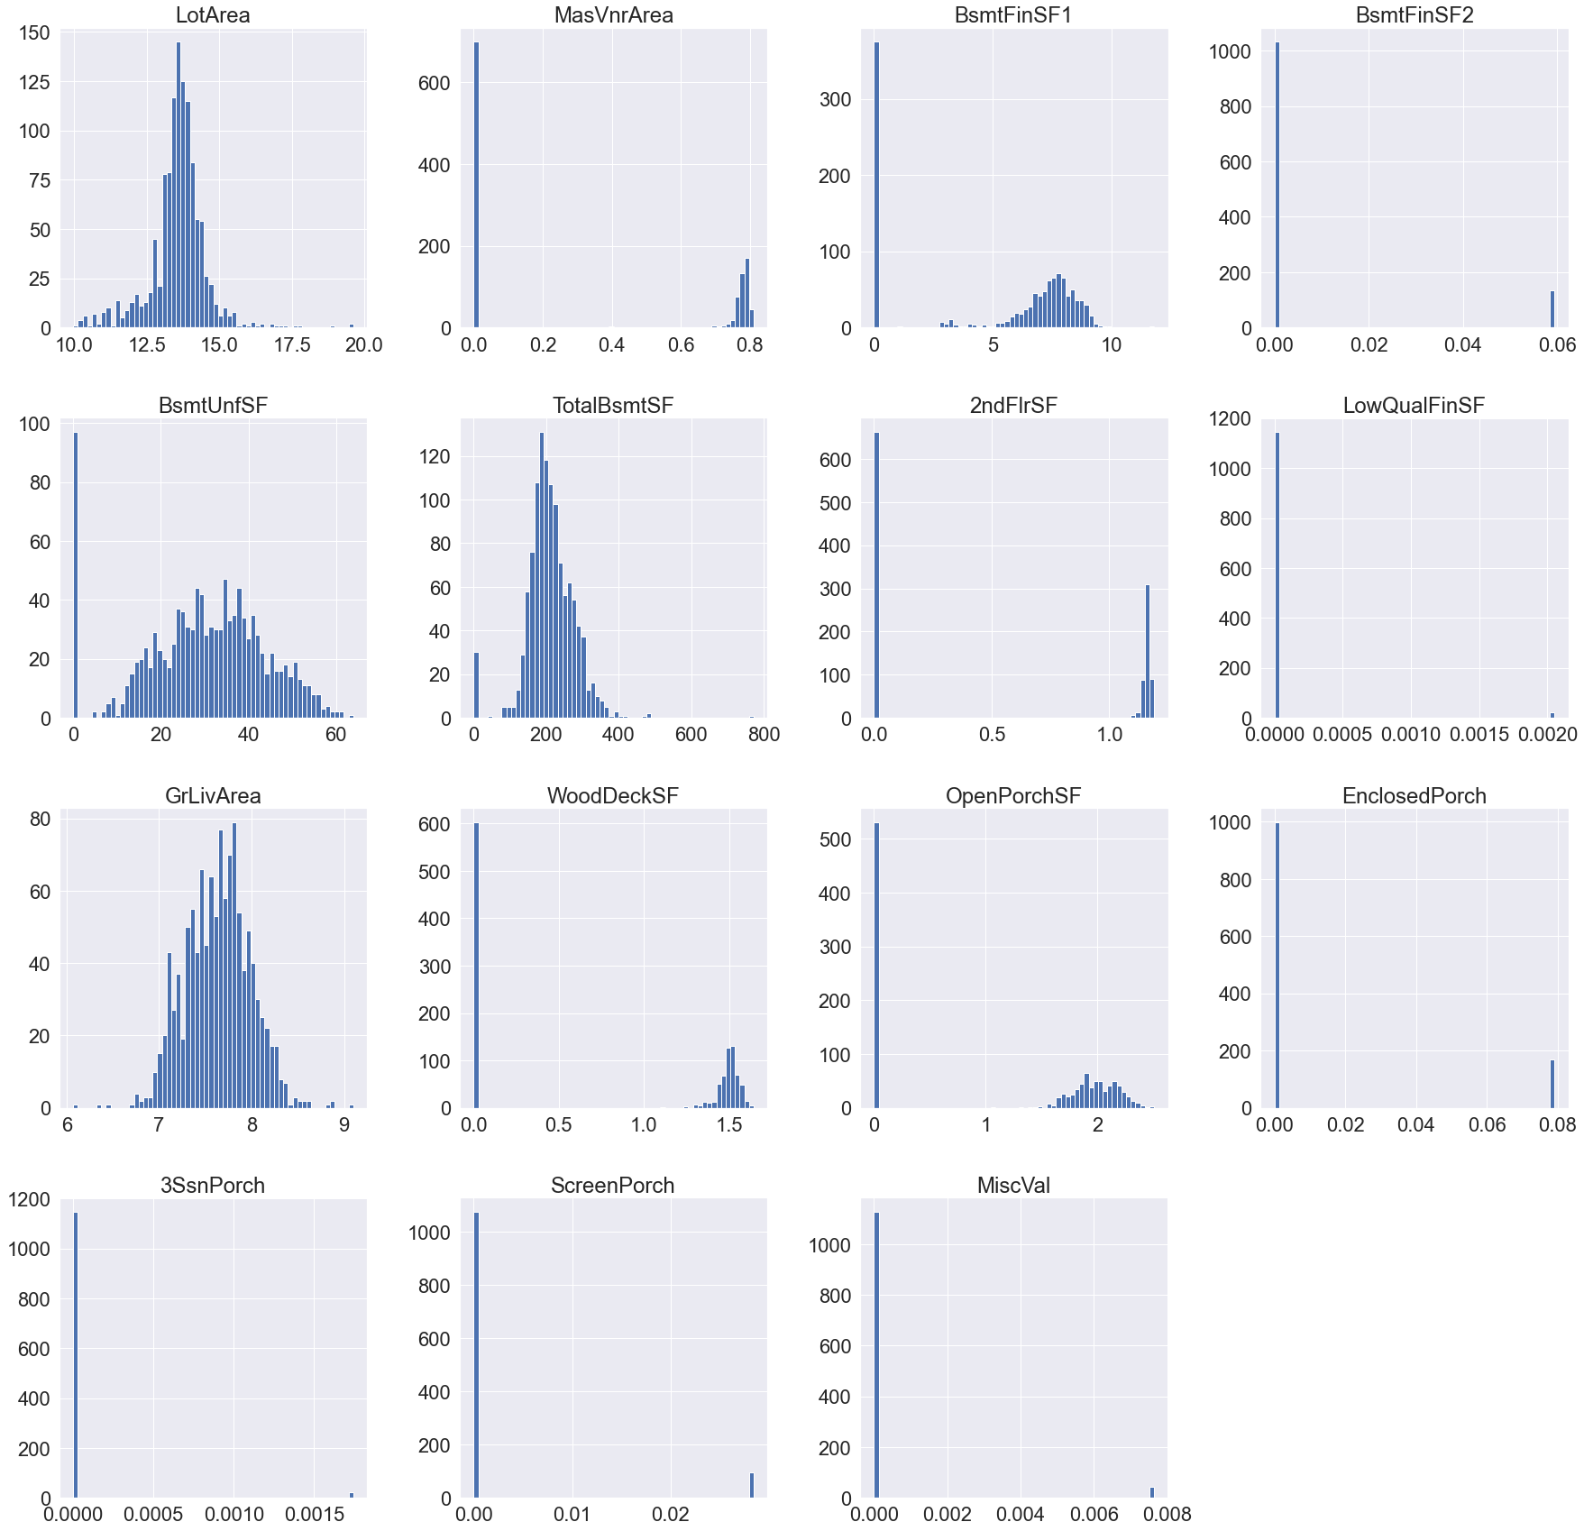
Power Transform:

Slide 20
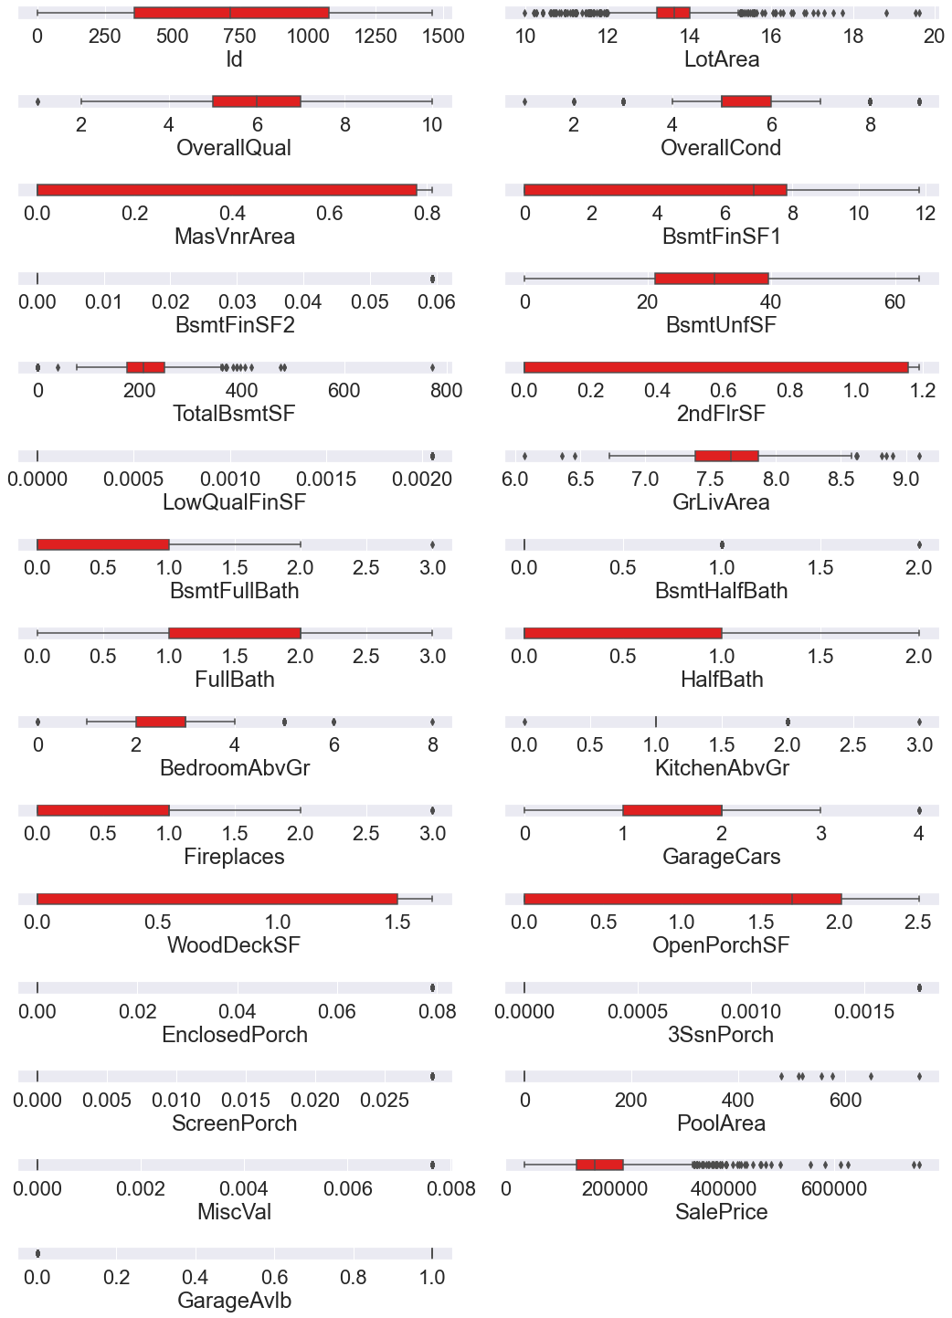
Checking For Outliers:- Since there is a large percentage of data as outliers, these outliers could be natural outliers.

Slide 21
Assumptions Made for Data Cleaning activities
Id is a unique identifier for each house. Hence dropped it.
The YearBuilt, YearRemodAdd, GarageYrBlt, YrSold, MoSold are all year and month data. But these are considered as categorical data while solving.
The missing values in some of the categorical features were because the house did not have that feature.
The Large numerical outlier values could be natural variations in the data.

Slide 22
Steps taken to complete the Project
Performed data cleaning based on the information provided and assumptions made.
Performed MinMaxScaler based scaling transformation.
Performed Yeo Johnson based transformation using ‘PowerTransformer’ to remove the skewness in the data.
Trained and validated different Machine Learning classification models(base and ensemble models) to select a suitable model.
Chose the final model based on R2 score and Mean Squared Error metrics.

Slide 23
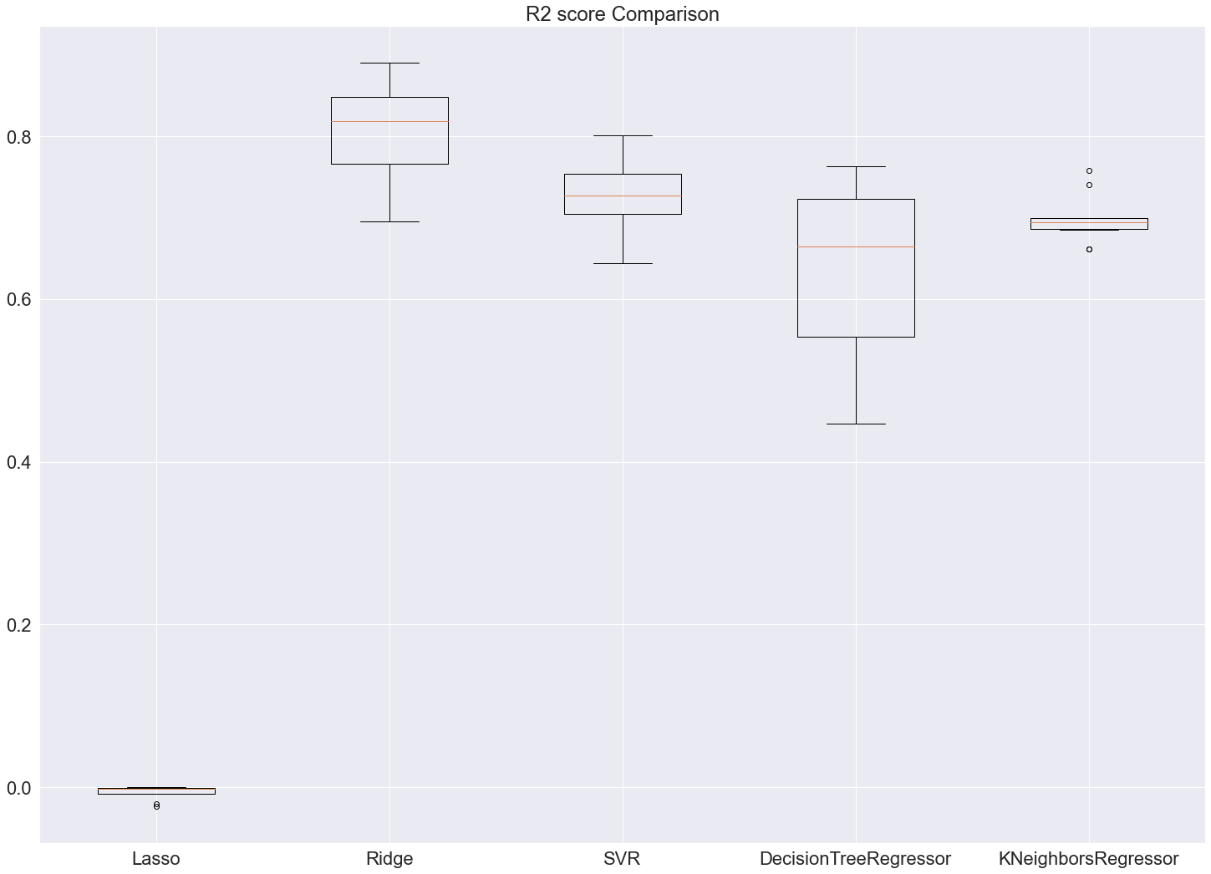
Simple Models

Slide 24
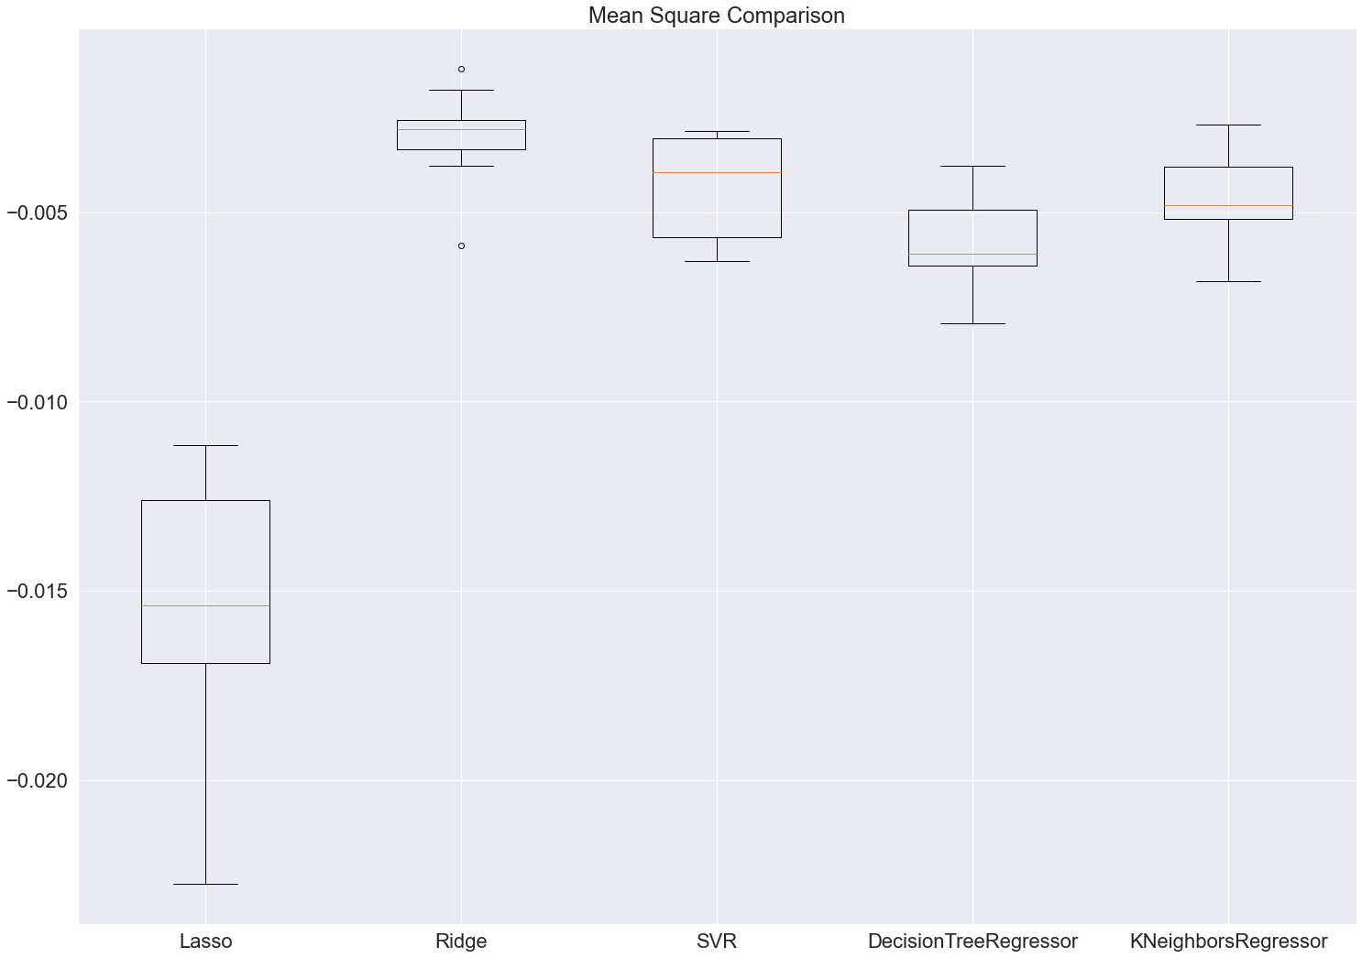
Ensemble models

Slide 25
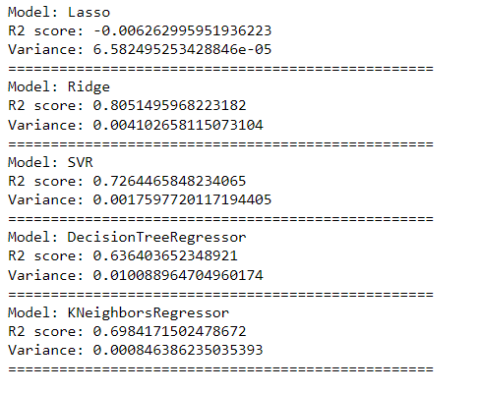
R2 Score & Variance

Slide 26
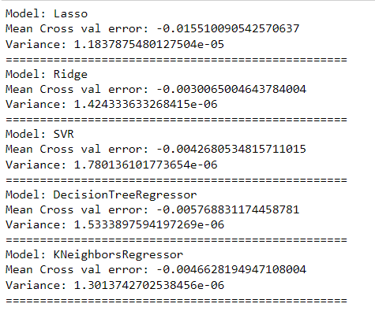
Mean Cross Val error & Variance

Slide 27
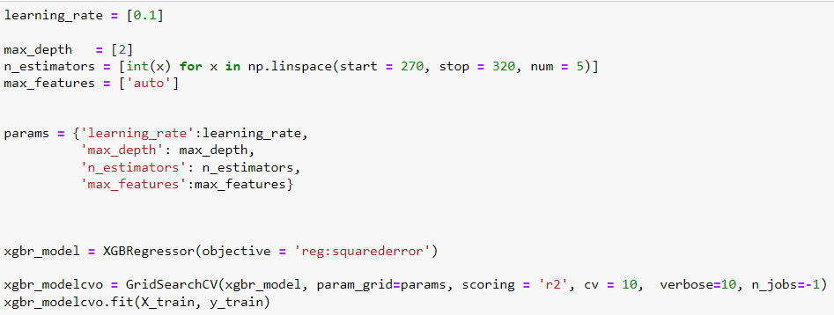
Hyper parameter tuning:

Slide 28
Final Model
The cross Val score of the final model with the whole train data is: 0.8827 and the Variance is: 0.000714
R2 score of whole Train data: 0.9525
Mean Square Error of whole Train data: 0.00078

Slide 29
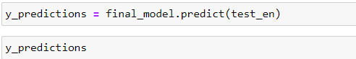
Testing Train Data with Test data for predictions

Slide 30
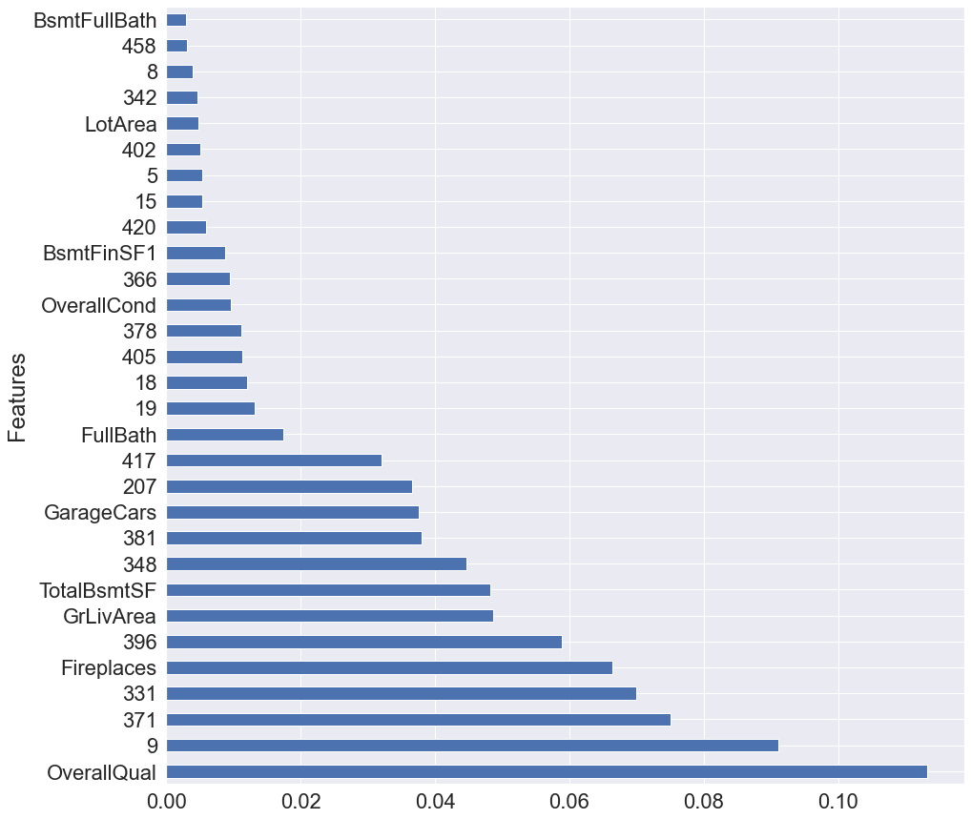
Best Features
The OverallQual, Fireplaces, GrLivArea, TotalBsmtSF, GarageCars, FullBath, OverallCond, BsmtFinSF1, LotArea, BsmtFullBath are the most influential Features to predict the target variable ‘SalePrice’.

